Slide 1
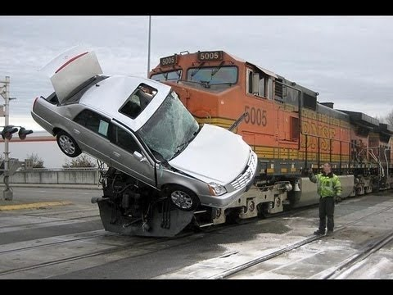
KSI Toronto Project
Group 1:
Sachin Kaushik - 301379467
Antony Tibursias Brightes Machado- 301380198
Namneet Kaur Tung - 301279374
Seyed Nariman Hosseini- 301321754
Muhammed Ikbal Ekinci - 301309283

Slide 2
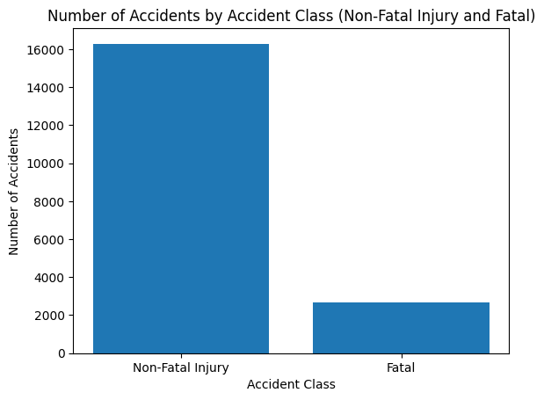
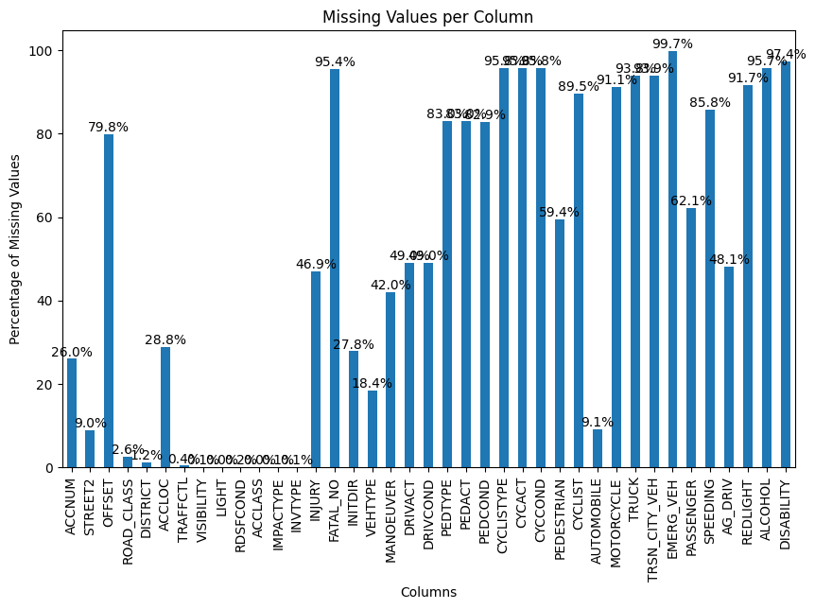
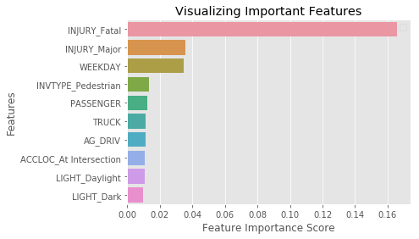
Phase 1 Recap - Data exploration & Data modeling
Target Class (ACCLASS: Fatal/NonFatal) had Imbalanced Distribution
High missing values column count
The injury column has a high correlation to the target column leading to overfitting

Slide 3
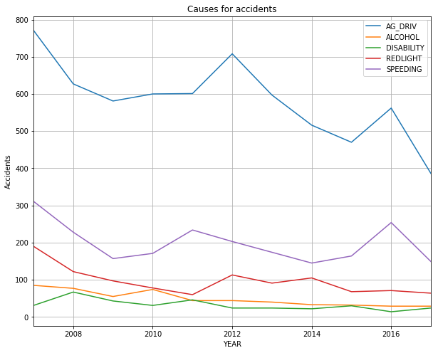
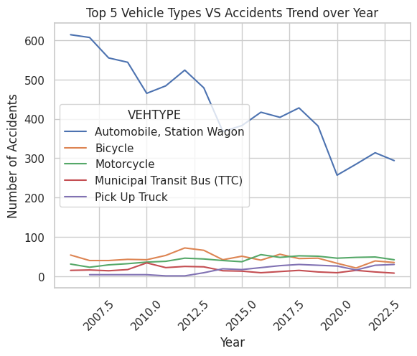
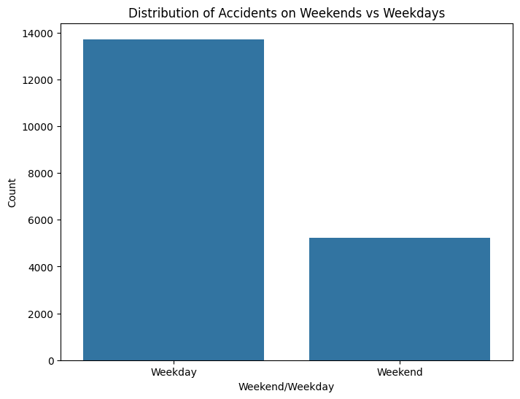
Phase 1 Recap - Data exploration & Data modeling
Cause of Accidents over the years
Accidents comparison with the type of the Day
Accident Trend over time: when explored with Vehicle types

Slide 4
Phase 1 Recap - Feature selection
Data Cleaning
Binary Columns Handling (transformed yes/no(or nan) to 1/0)
Missing Values Handling (Dropped column having >50% missing values))
Categorical Values Handling (Label, One Hot Encoding)
Feature Engineering
Features Extracted (Season, Weekday/Weekend etc.)
Feature Grouping (Vehicle Type, Road Surface Condition etc.)

Slide 5
Phase 2

Slide 6
Data modeling
Feature Importance:
Method: Extra Trees Classifier to determine important features.
Technique: Chi-Square used to measure correlation with the target feature (Fatal).
Feature Reduction:
Removed Features: Unique identifiers, duplicate data, random values, or irrelevant features (e.g., Accident number, Hood_140).
Features Selected for Training:
Numeric Features: VISIBILITY, LIGHT, RDSFCOND, Driver, PEDESTRIAN, CYCLIST, AUTOMOBILE, MOTORCYCLE, TRUCK, TRSN_CITY_VEH, EMERG_VEH, PASSENGER, SPEEDING, AG_DRIV, REDLIGHT, ALCOHOL, DISABILITY, Primary_Road, Weekend, At Intersection, Fatal_Injury
Categorical Features: DISTRICT, DRIVACT_GROUPED, INVAGE_GROUPED, DRIVCOND_GROUPED, VEHTYPE_GROUPED, TRAFFCTL_GROUPED

Slide 7
Pipeline
Feature Identification: The pipeline automatically separates numeric and categorical features in the dataset.
Handling Missing Data: For categorical features, missing values are filled with 'missing' using SimpleImputer. For numeric features, the median value is used.
Feature Encoding: Categorical features are one-hot encoded with OneHotEncoder, which handles unknown categories effectively.
Feature Scaling: Numeric features are standardized with StandardScaler to ensure they are on a similar scale.
Data Splitting: The data is split into training and testing sets, with 20% reserved for testing.

Slide 8
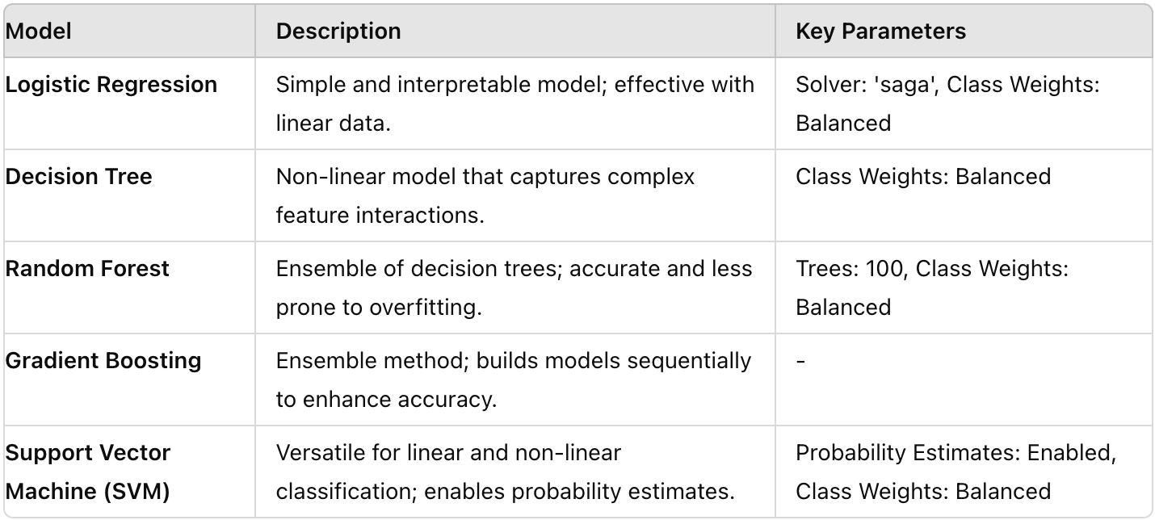
Model Building- Models Used

Slide 9
Model Building- Model Training and Evaluation Process
SMOTE Integration:
Applied SMOTE (Synthetic Minority Over-sampling Technique) to address class imbalance.
Model Training:
Trained each model on the preprocessed training data.
Prediction:
Used trained models to make predictions on the test set.
Performance Metrics:
Accuracy: Frequency of correct predictions.
Precision: Percentage of correct positive predictions.
Recall: Percentage of actual positives correctly identified.
F1 Score: Harmonic mean of precision and recall.
AUC (Area Under the ROC Curve): Ability to distinguish between classes.
Cross-Validation:
Performed 3-fold cross-validation with a focus on AUC score to ensure result reliability.

Slide 10
Model Comparison and Selection
Objective: Prioritize recall to maximize identification of "Killed" cases.
Recall: Measures the proportion of actual positives (individuals who were killed) correctly identified by the model.
Importance: High recall is crucial for capturing the majority of "Killed" cases, even if it increases false positives.
Best Model Selection Criteria:
AUC Score: The model with the highest AUC score was chosen as the best model for its performance across all metrics.

Slide 11
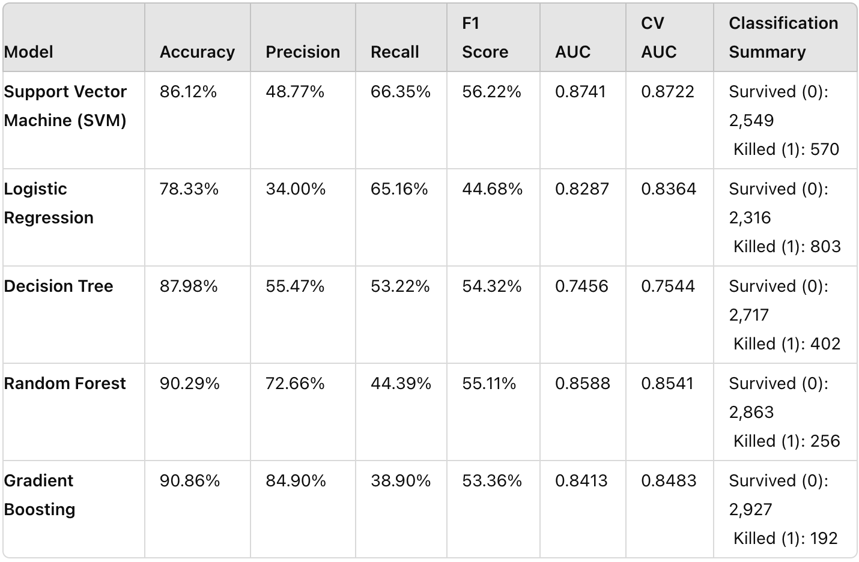
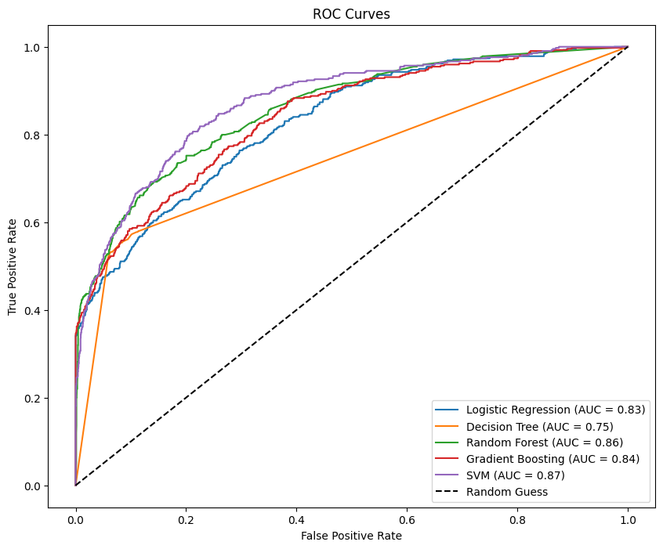
Model Performance Results

Slide 12
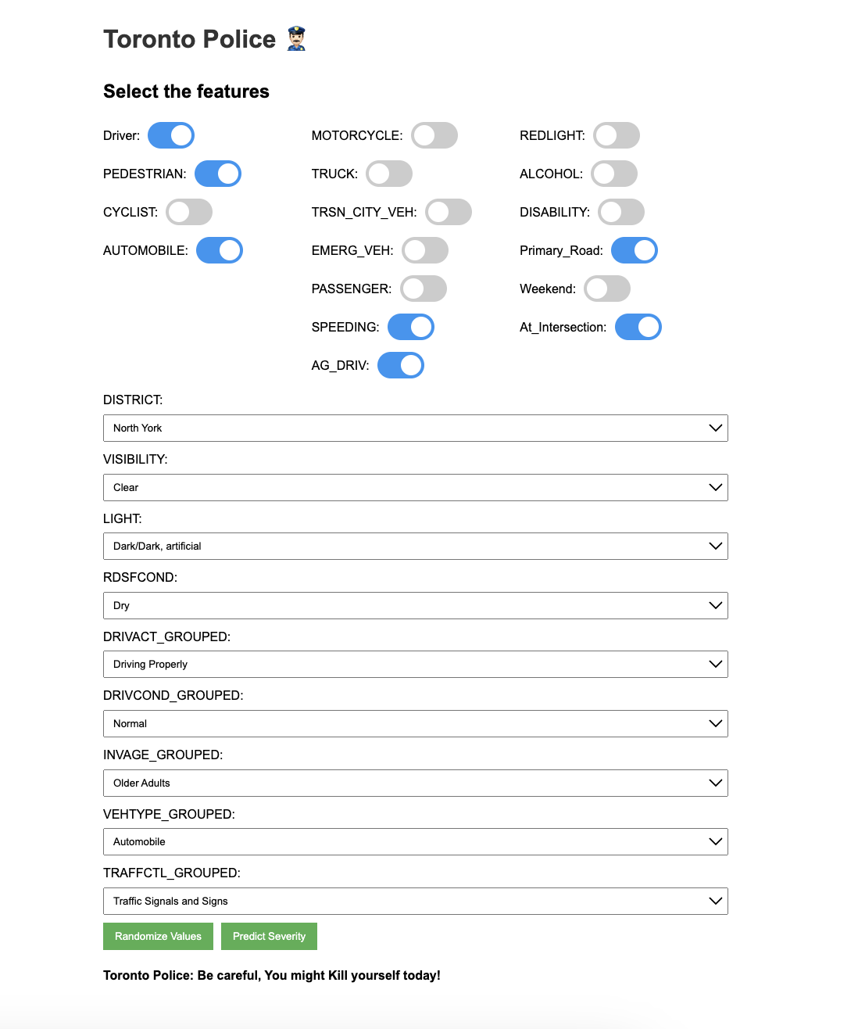
Flask API Integration

Slide 13
Thankyou!

